Slide 1
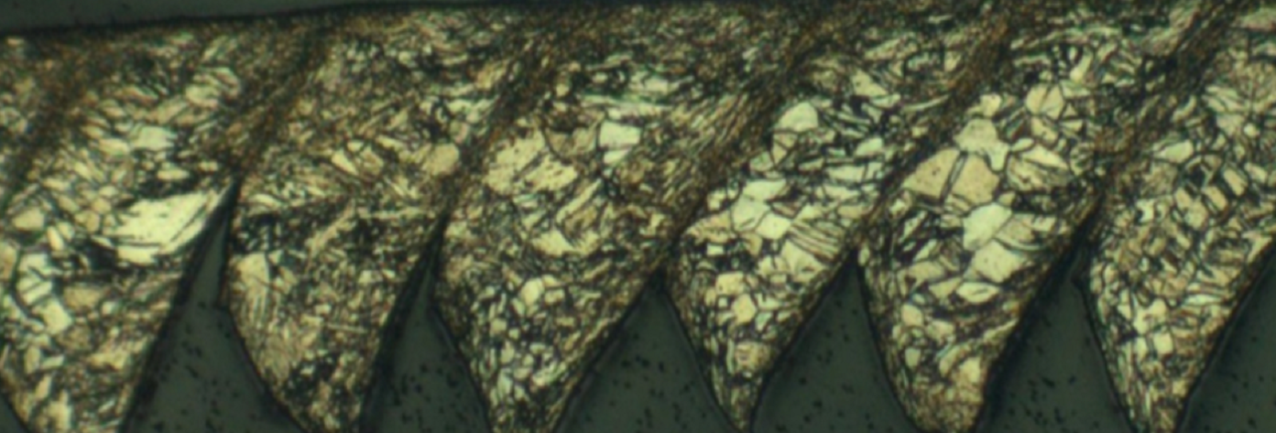
Exploring Process Structure Linkages in Machined Chips
Patxi Fernandez-Zelaia
Ahmet Cecen
December 8, 2014
Material Informatics ME/MSE/CSE 8883

Slide 2
Overview
Machining Introduction
Processing Effects on Microstructure
Problem Statement
Experimental
Image Processing
Data Analysis
Results
Conclusions

Slide 3
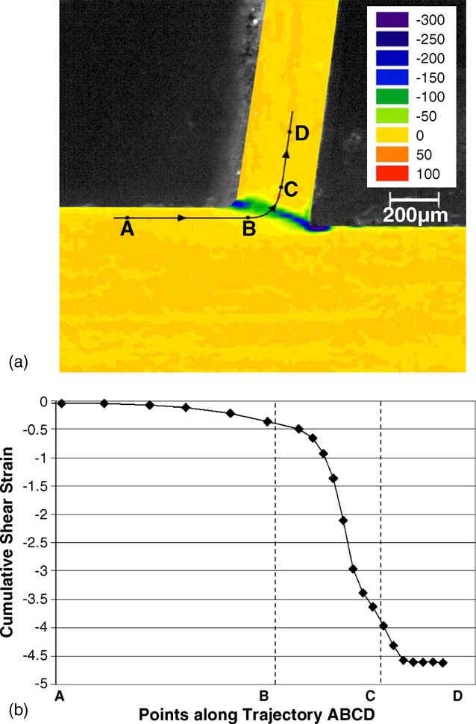
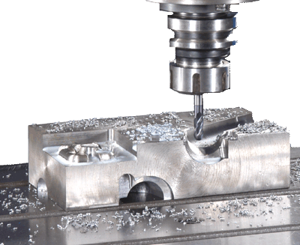
Machining Introduction
Machining processes often follow primary shaping
Large imposed strains under high rate deformation
Up to ~10⁵ s⁻¹, ε=~1-15
Large temperature rise
“Large strain deformation and ultra-fine grained material by machining” Swaminathan et al. 2005

Slide 4
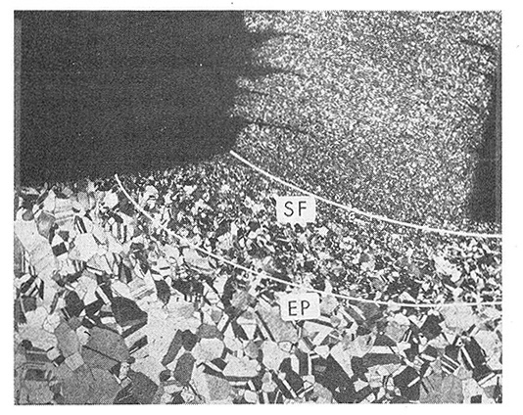
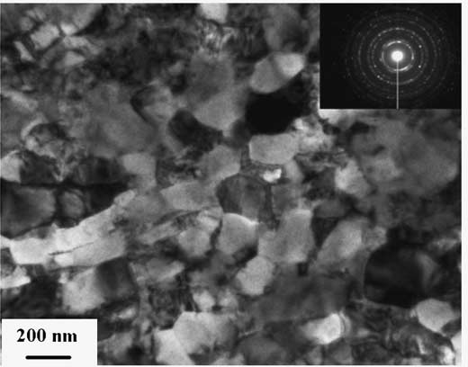
Processing Effects on Microstructure
Thermo-mechanical loading induces microstructural evolution
Grain refinement
Dislocation density evolution
Twinning
…
“On the Metal Physical Considerations in the Machining of Metals” Ramalingam & Black 1972
“Large strain deformation and ultra-fine grained material by machining” Swaminathan et al. 2005

Slide 5
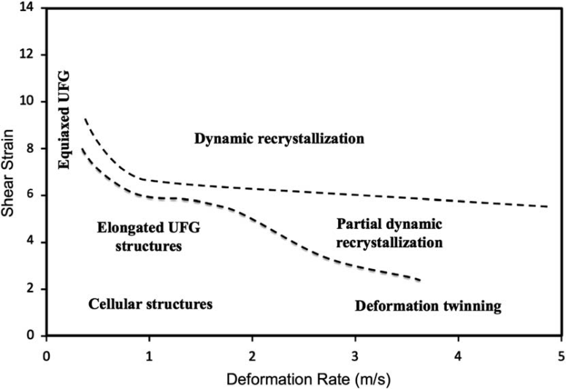
Problem Statement
Manufacturing community has begun to study process-structure relationships in machining
Our goal is to explore process-structure linkages while quantifying structure gradients present in machined chips and
“A study of the interactive effects of strain, strain rate and temperature in severe plastic deformation of copper” Brown et al. 2009
250μm

Slide 6
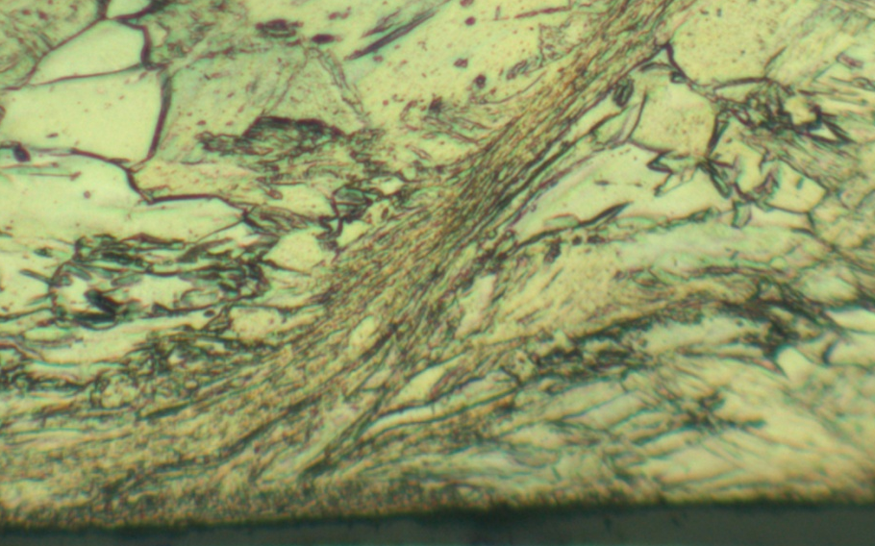
Problem Statement
Focus in this study is to first attempt to quantify gradients in the vertical direction (x-dir)
Analyze 7 unique processing conditions
Explore linkages in PCA space
250μm
x

Slide 7
Experimental
Orthogonal cutting experiments performed varying:
Feed (f)
Cutting velocity (V)
Process conditions (f,V) affect thermomechanical processing and hence structure
CP-Ti (Gr 5) chips collected, etched and imaged using optical microscopy
5 images taken along the length of each chip
Assuming all segments in a chip are representative of the imposed processing conditions
chip
f
V
workpiece

Slide 8
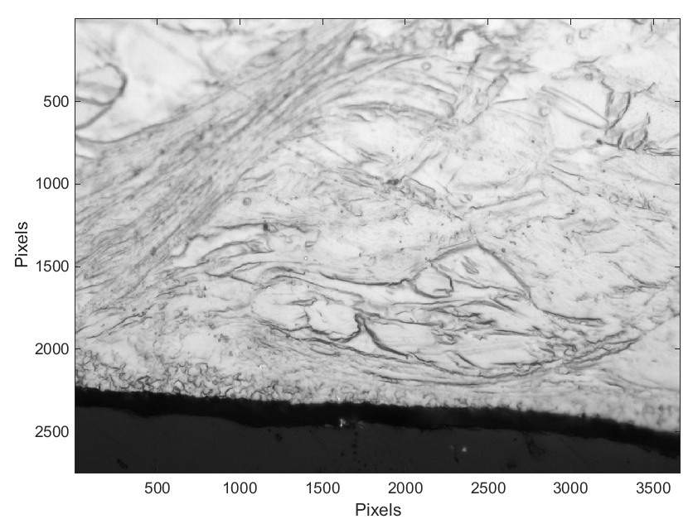
Image Processing

Slide 9
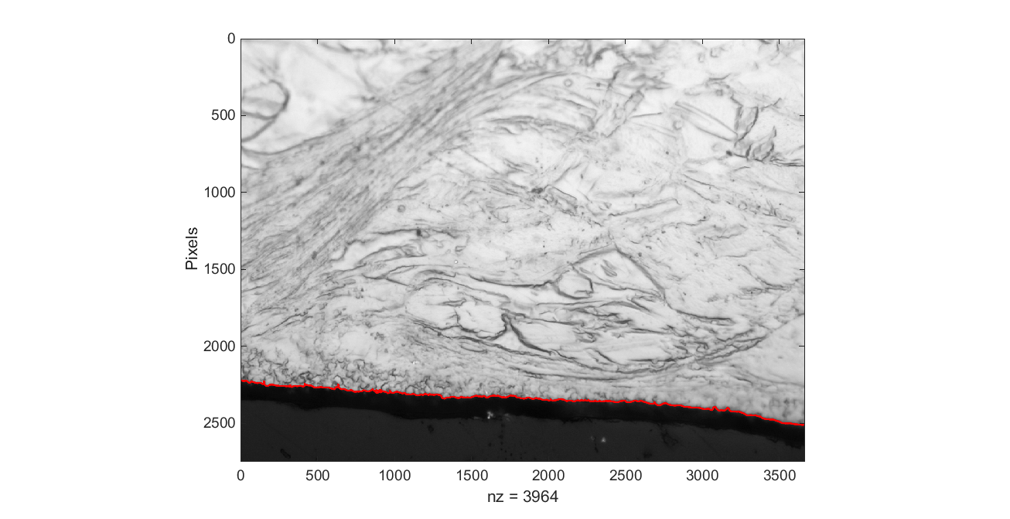
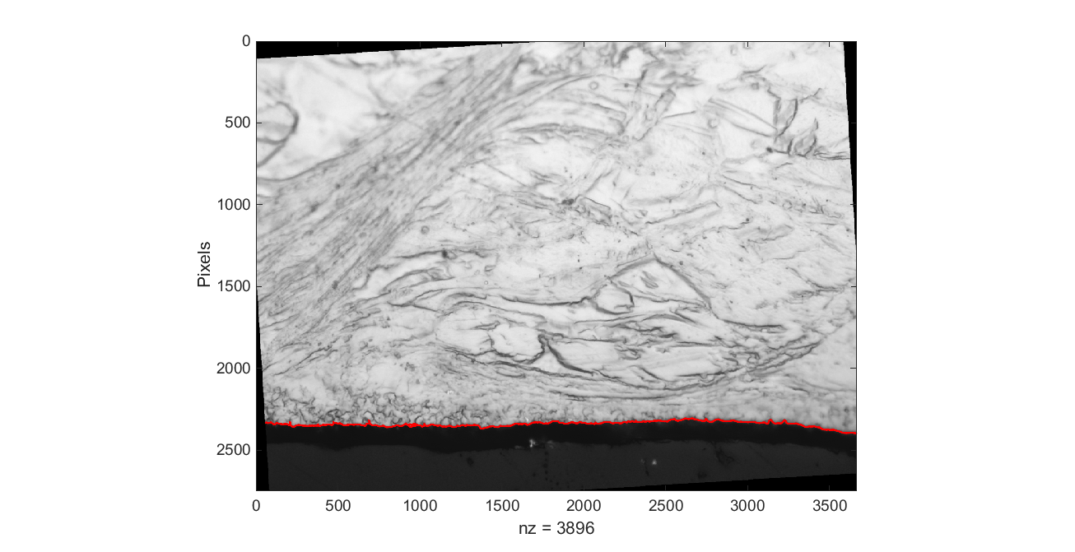
Image Processing

Slide 10
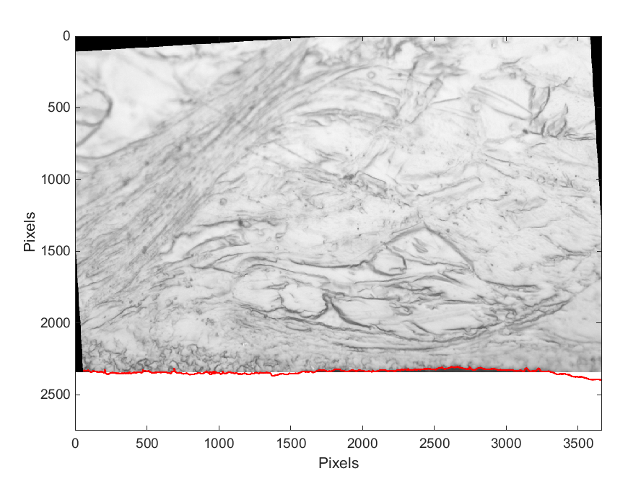
Image Processing
20 Pixel Offset

Slide 11
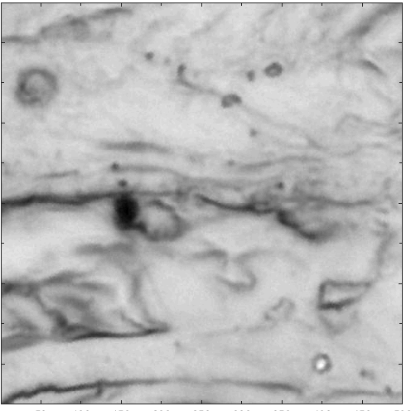
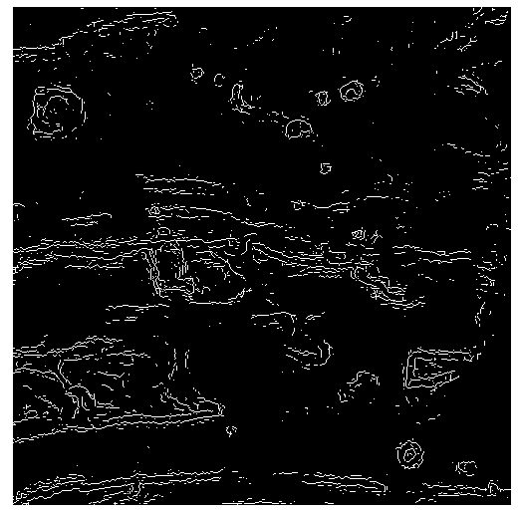
Image Processing
Canny Edge Detection
( Gaussian Blur - > First Gradient - > Thresholding)

Slide 12
Data Analysis
Chord Length Distribution

Slide 13
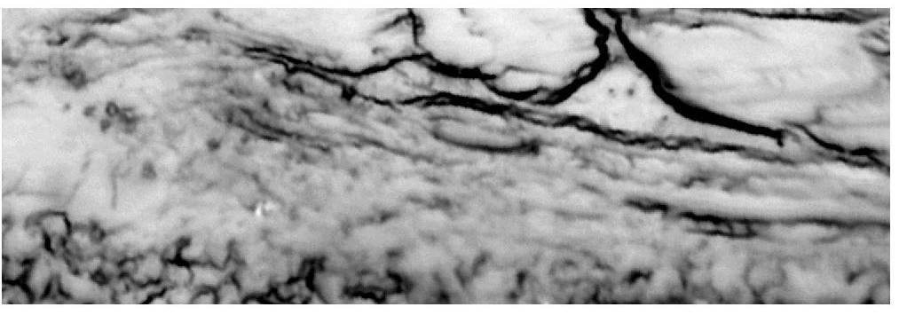
Chord Length Distribution
Two distributions were considered
(1) lacks sufficient sensitivity to quantify structure
(2) weights larger chords and as such is more useful
Chord length distribution displays expected trends. The reweighted distribution highlights longer length scales.
P(X=x) probability that a chord is length x
P(X=x) probability that a pixel is found in a chord of length x

Slide 14
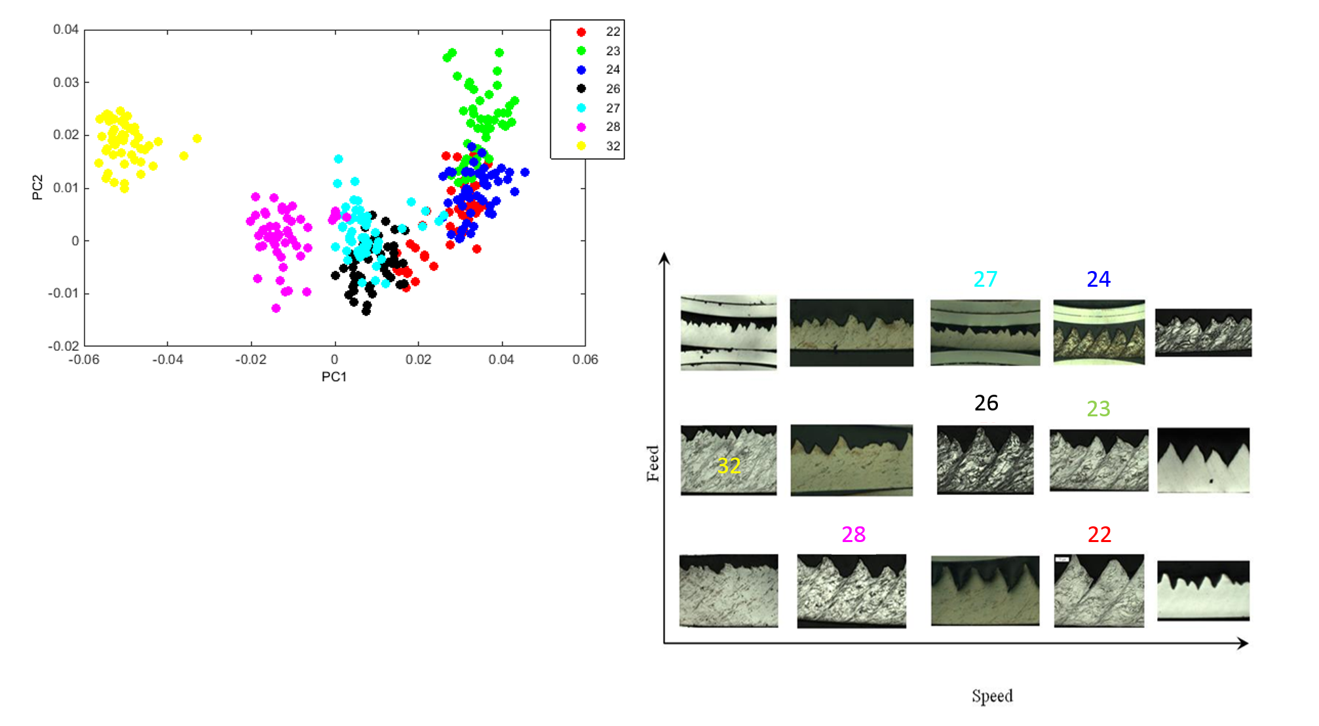
Results
The dataset shows clear clustering across different Speeds, but does not separate well with Feed.
Top 50 Rows of Each Dataset

Slide 15

Results
1
2
3
4

Slide 16
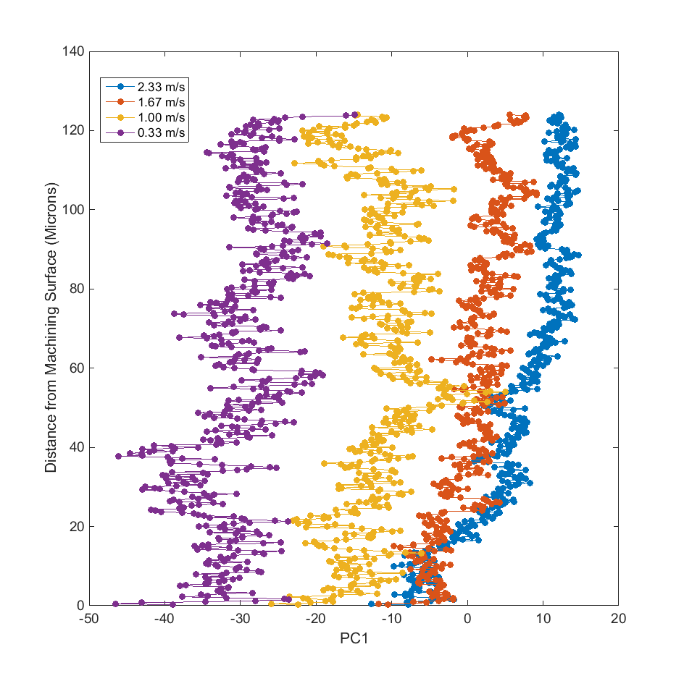
Results
The dataset clusters well into distinct regions based on speed farther away from the machining surface, while showing very unstable clustering close to the surface.

Slide 17
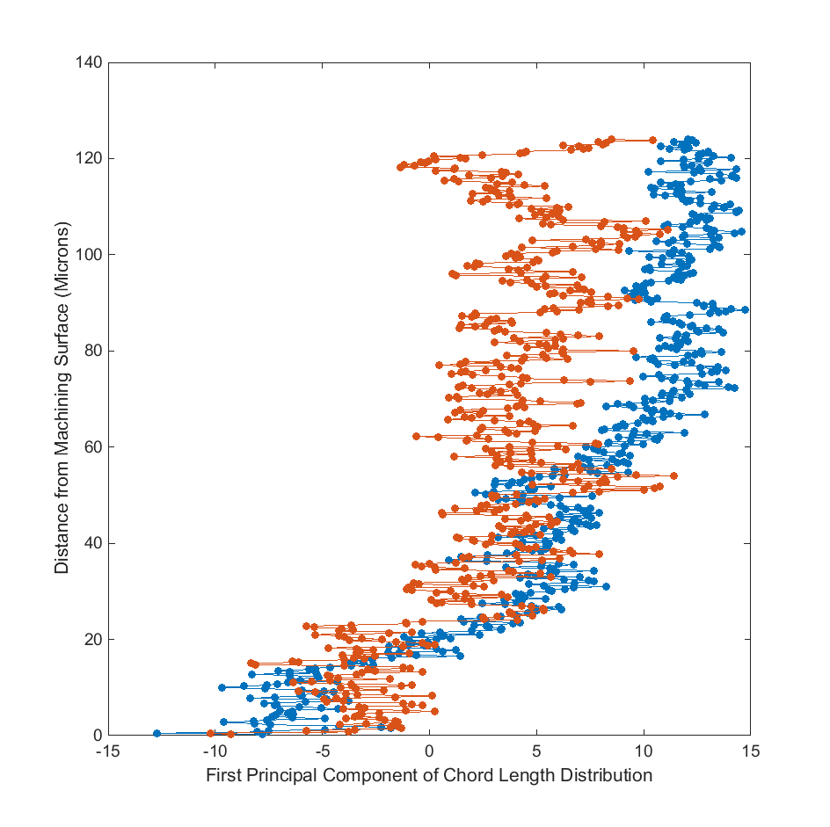
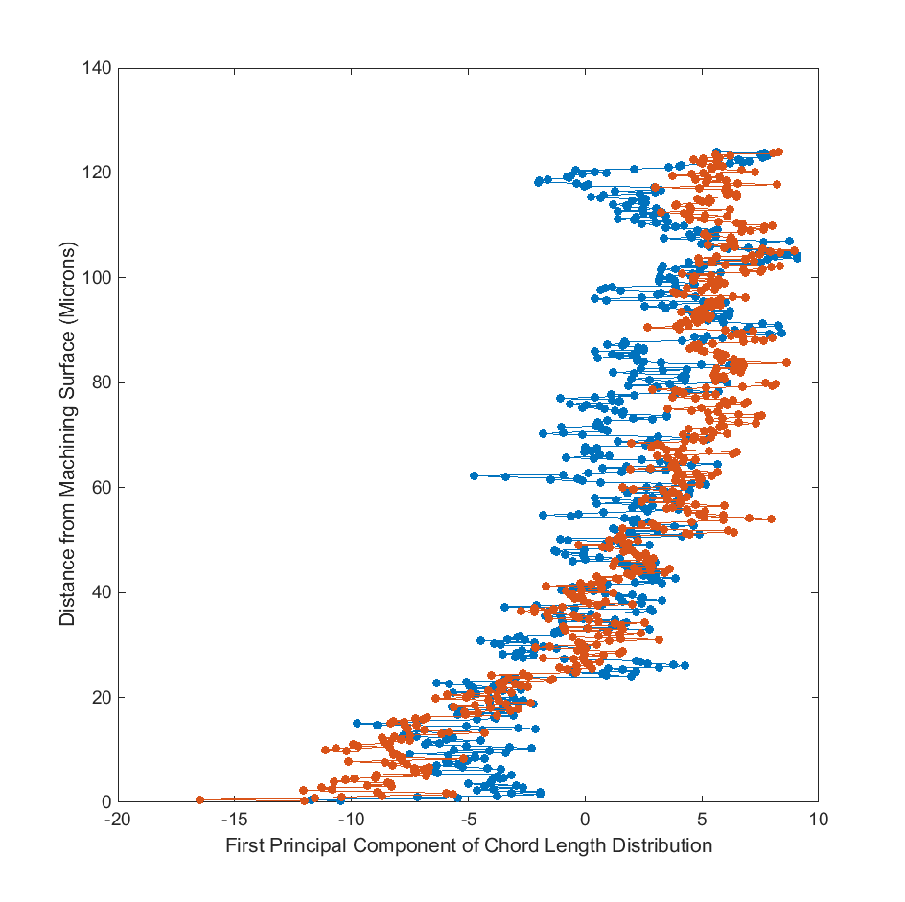
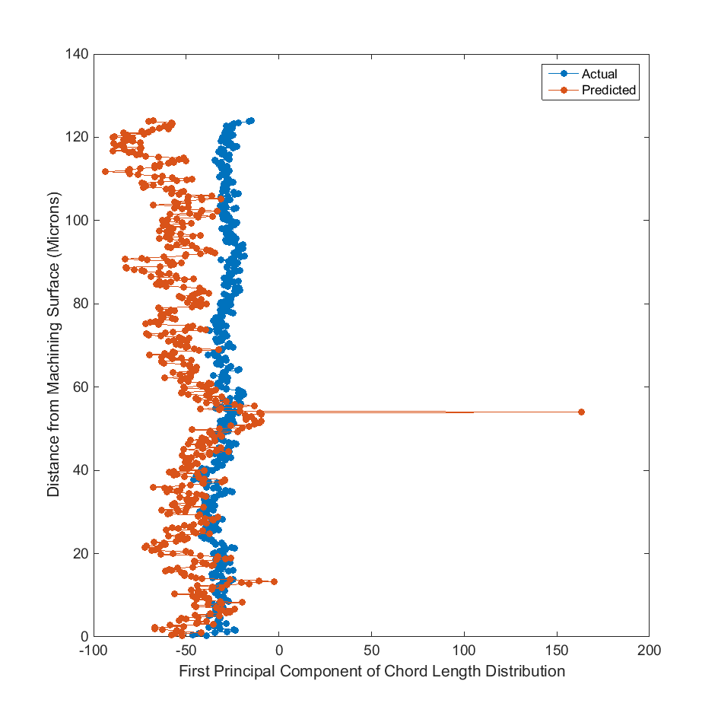
Machine Learning
Can we predict PC1 for any given speed given the three remaining speeds?
2.33 m/s
1.67 m/s

Slide 18
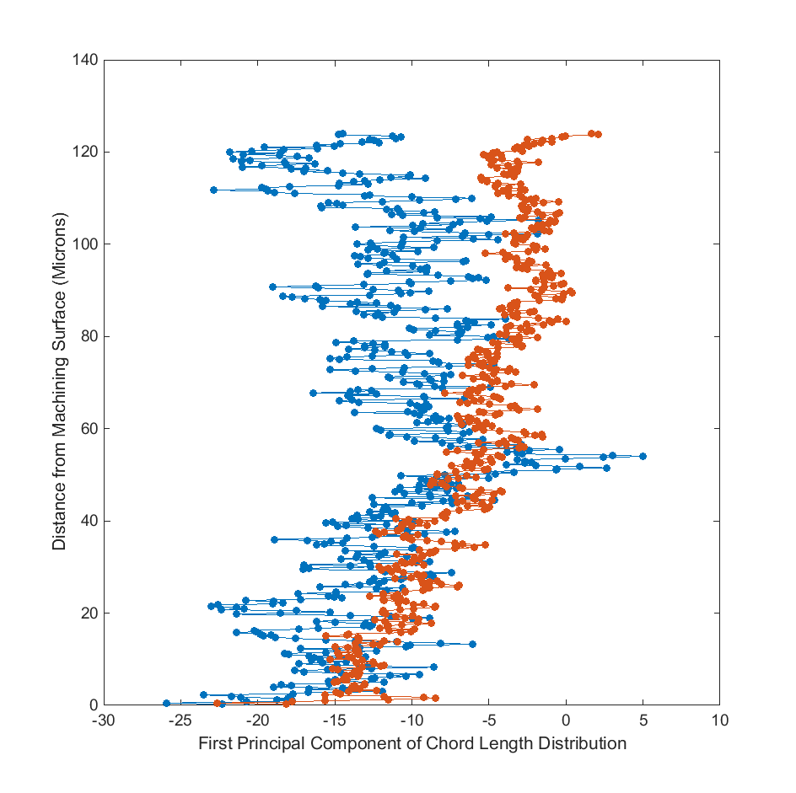
Machine Learning
Can we predict PC1 for any given speed given the three remaining speeds?
1.00 m/s
0.33 m/s

Slide 19
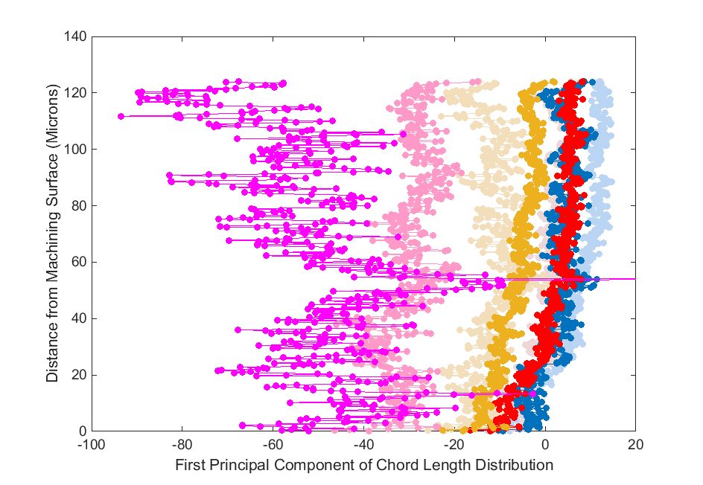
Results
A simple regression based learner provides stable estimates for interpolating and extrapolating vertical gradient from the machine surface.
Speed

Slide 20
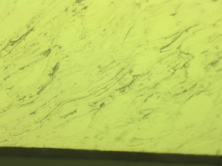
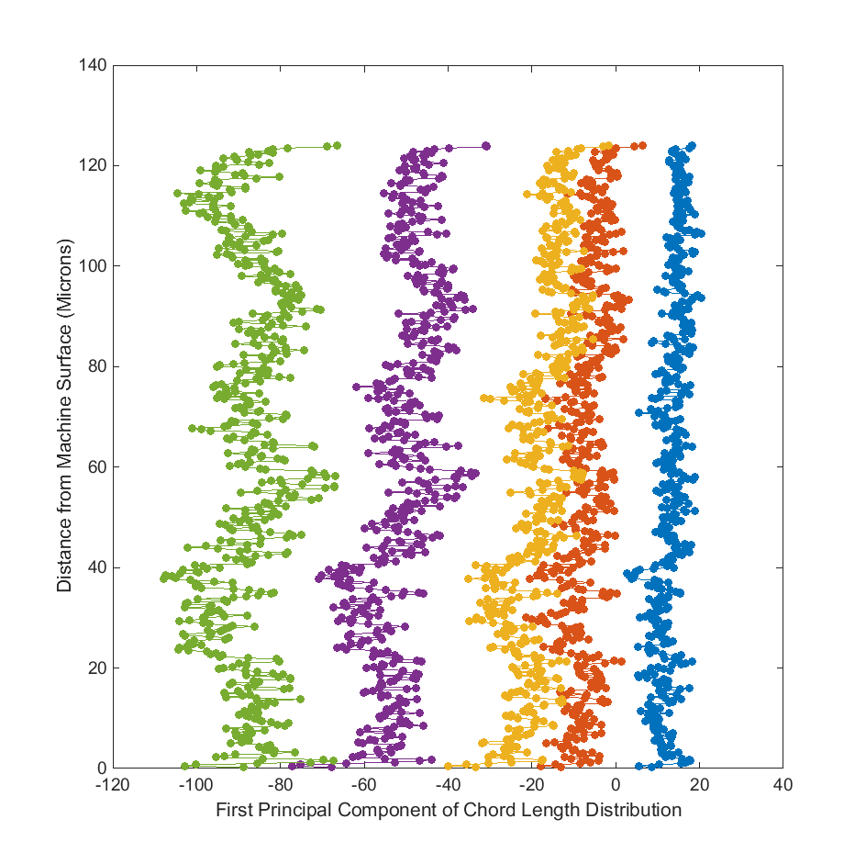
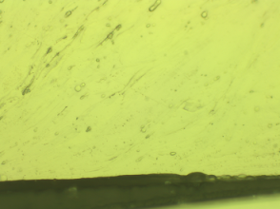
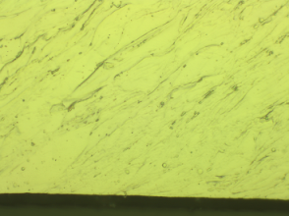
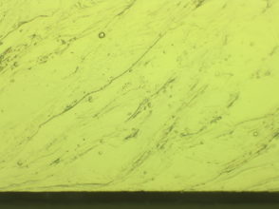
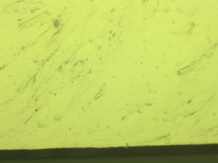
Etching Gradients
Acquisition Order

Slide 21
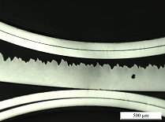
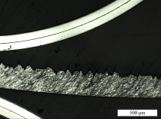
Etching Gradients
All samples illustrated varying degrees of etch gradients
Sample 32 displayed greatest degree of etch gradient
Effects of etch gradient displayed in PCA space
Etch Gradient
Sample 32

Slide 22
Future Work
More Reliable Imaging
Different Polishing and Etching Techniques
SEM
Nano-Indentation Data
Alternative method for inferring local structure.
More refined discretization of speed/feed.
Incorporating cutting force measurements in to the learning process.
Accounting for the Etching Gradients

Slide 23
Conclusions
Current techniques are fairly successful in classifying the structure towards the inner parts of the chips for the current dataset.
The current techniques cannot resolve information close to the machining surface as distinctly as the information farther away.
Uneven etching effects were found to be effectively captured by the principal components of chord length distribution.
Process path learning was demonstrated with variable accuracy on the given dataset. Substantial improvements were possible, but not explored, due to the current limitations and amount of data.

Slide 24
Questions?

